Slide 1
Class And object
Examples
By
Manoj Yekolla

Slide 2
Class
A Class is a Blueprint of specific object.
It does not Consume any memory space.
In real world every object has some colour,shape and functionalites-for Eg
Every single car of BMW,Cadillac are an object of the class called ‘Luxary Car’ .Here , Laxary car is a class ,for every single physical car is an object of the laxuary car class.

Slide 3
Object
Object is a Real world entity , for example chair ,pen,mobile,laptop etc.
In other words ,Object is a entity that has state and behaviour.Here state means Data and behaviour means functionality.
Object is a instance of class . All the members of the class can be accessed through object.

Slide 4
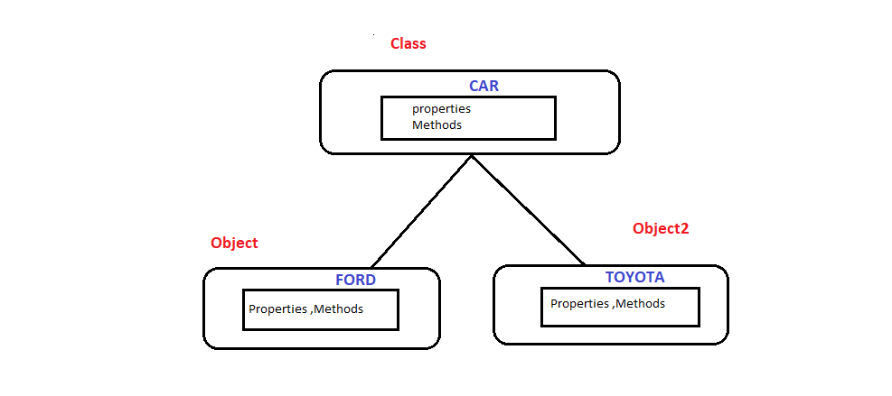
Example

